Slide 1

DSA FROM ZERO | DAY 12- MK TECHVERSE
Linear Search
The simplest way to find an element — and the foundation of every search algorithm you'll ever learn. Let's break it down step by step. 🚀

Slide 2

What Is Linear Search?
Linear search is the most straightforward searching technique. Given an array of elements, you scan through one by one until you find your target — or run out of elements to check.
🔍 Search
➡️ Sequential
Find a specific element inside an array
Check elements one at a time, left to right
✅ Simple
No sorting or extra setup required

Slide 3


The Problem
You're given an array and a target value. Your goal: find the index where the target lives.
Array: [2, 5, 8, 10] Target: 8 Expected Output: Index 2
The array is unsorted or sorted — it doesn't matter. Linear search works on both. We just want to locate the value.

Slide 4

The Core Idea
Compare to Target
Check Element
Stop & Return
No tricks, no shortcuts — just a clear loop with a condition. If the current element matches the target, you're done. If not, move to the next one.

Slide 5
The Approach
1
2
Start at Index 0
Compare Each Element
Always begin from the very first element of the array.
Check if arr[i] == target at every step.
3
4
Match Found → Return Index
No Match → Continue
If the element equals the target, return the current index i.
Increment i and repeat for the next element.

Slide 6
Dry Run — Step by Step
1
arr[0] = 2 → 2 ≠ 8 ❌
Array: [2, 5, 8, 10]
Not a match. Move to the next element.
Target: 8
2
arr[1] = 5 → 5 ≠ 8 ❌
Result: Index 2 ✅
Still no match. Keep going.
We only needed 3 comparisons to find our answer. In the best case, it's found immediately. In the worst case, we check every element.
3
arr[2] = 8 → 8 = 8 ✅
Match found! Return index 2.

Slide 7
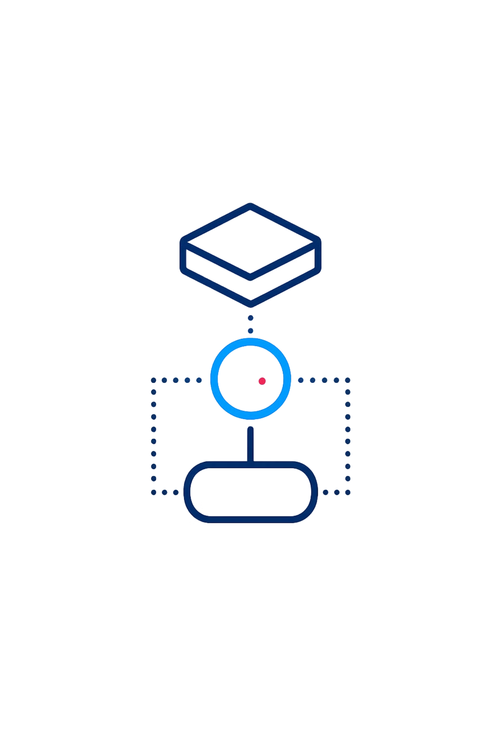
What If It's Not Found?
Sometimes the target simply doesn't exist in the array. In that case, the loop finishes without ever finding a match — and we return -1 as a signal to the caller.
Loop Completes
Every element has been checked — none matched the target.
Return -1
-1 is a convention meaning "not found." It's an invalid index, so it's safe to use as a sentinel value.

Slide 8



Complexity Analysis
What Does This Mean?
O(n) time means performance scales linearly with array size. Double the array → double the comparisons in the worst case.
O(1) space means we use a constant amount of memory — no extra arrays or data structures needed. Just a loop counter.
💡 Linear search is not the fastest — but it's the most universal. It works on any array, sorted or not.

Slide 9
What You Learned Today
Searching Logic
Loop Usage
Condition Checking
How to scan an array systematically to locate a target value.
Using a for loop to iterate through every element from index 0 to n-1.
Applying an if statement inside a loop to match and return early.

Slide 10

🧠 Mini Challenge
Try It Yourself!
Apply linear search to the following:
Array: [4, 7, 1, 9] Target: 1 What index is returned?
Trace through the array manually — check each element one by one. What comparisons do you make before finding the match?
💡 Hint: Start at index 0 and compare each element with 1 until you find a match.

